Slide 1
Sql Final project
Project video https://drive.google.com/file/d/1GZ3D5f14nprw5LWg8ykMAz5Lzens2LTk/view?usp=sharing

Slide 2
Task 1 Explanation
1. Extracted monthly sales for each branch using the DATE_FORMAT() function to group data by month.
2. Used a window function LAG() to get the previous month's sales per branch.
3. Calculated month-over-month sales growth using the formula: (current month sales- previous month sales/ previous month sales)* 100
4- Averaged the growth rates to find the branch with the highest average sales growth.
Analysis : Branch A has showed the best average growth rate.
Query Used - WITH monthly_sales AS ( SELECT branch, DATE_FORMAT(sales_date, '%b') AS Months, ROUND(SUM(total), 2) AS Total_Sales FROM walmartsales GROUP BY branch, Months),sales_growth AS ( SELECT branch, Months, Total_Sales, LAG(Total_Sales, 1) OVER (PARTITION BY branch ORDER BY Months) AS Previous_Month_Sales, ROUND( ( (Total_Sales - LAG(Total_Sales, 1) OVER (PARTITION BY branch ORDER BY Months)) / LAG(Total_Sales, 1) OVER (PARTITION BY branch ORDER BY Months) ) * 100, 2 ) AS Growth_Rate FROM monthly_sales),avg_growth AS ( SELECT branch, ROUND(AVG(Growth_Rate), 2) AS Avg_Growth_Rate FROM sales_growth WHERE Growth_Rate IS NOT NULL GROUP BY branch)SELECT *FROM avg_growthORDER BY Avg_Growth_Rate DESCLIMIT 1;
Branch | Avg Growth Rate (%)
A | 13.45

Slide 3
Task 2 : Explanation
Calculated total profit as: Cogs – Gross Income
Used SQL aggregation (SUM) to compute total profit and ROUND for cleaner formatting.
Calculated Profit Margin % = Profit/Cogs * 100.
Applied ROW_NUMBER() with PARTITION BY branch to find the top product line by profit for each branch.
Analysis:
The most profitable product lines identified were:
Branch A: Home and Lifestyle – ₹20,822.22 profit
Branch B: Sports and Travel – ₹18,084.56 profit
Branch C: Food and Beverages – ₹21,503.34 profit
Query used - with Profit as(select branch, `product line`, round(sum(cogs- `gross income`),2) as Total_Profit,round(round(sum(cogs- `gross income`),2)*100/sum(cogs),2) as Profit_margin,ROW_NUMBER() OVER (PARTITION BY branch ORDER BY round(sum(cogs - `gross income`), 2) DESC) AS Rnfrom walmartsalesgroup by branch, `product line`)select * from Profitwhere Rn = 1;
Branch | Product Line | Total Profit | Profit Margin (%)
A | Home and Lifestyle | ₹20,822.22 | 95
B | Sports and Travel | ₹18,084.56 | 95
C | Food and Beverages | ₹21,503.34 | 95

Slide 4
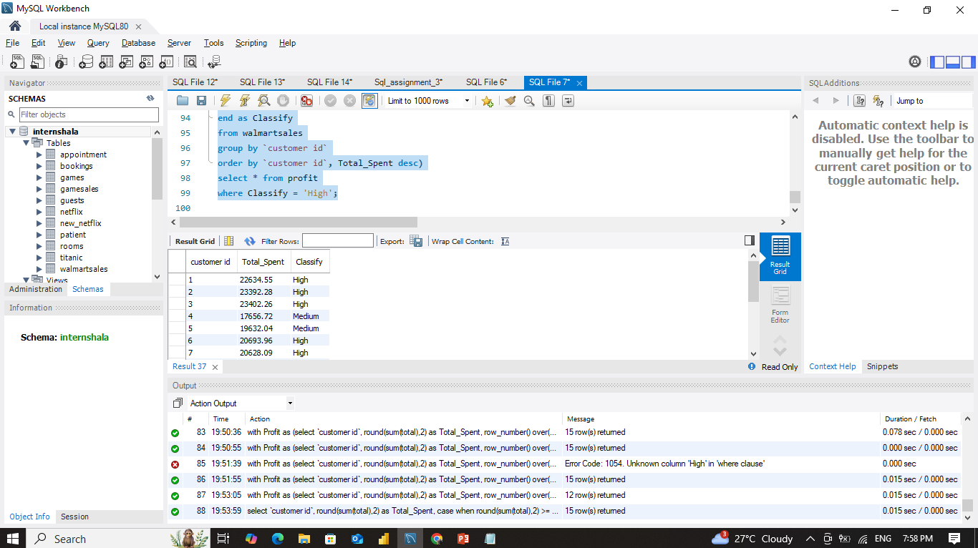
Task 3: Explaination
Used group by and case to classify the customer id based on total sales. Also used CTE in another query for better clarity and analysis.
Query used 1 normal classification- select `customer id`, round(sum(total),2) as Total_Spent,casewhen round(sum(total),2) >= 20000 then 'High'when round(sum(total),2) >= 10000 then 'Medium' else 'Low'end as Classifyfrom walmartsalesgroup by `customer id`order by `customer id`, Total_Spent desc;
Query with CTE : with Profit as(select `customer id`, round(sum(total),2) as Total_Spent,row_number() over(partition by `customer id` order by sum(total) desc) as Rn,casewhen round(sum(total),2) >= 20000 then 'High'when round(sum(total),2) >= 10000 then 'Medium' else 'Low'end as Classifyfrom walmartsalesgroup by `customer id`order by `customer id`, Total_Spent desc)select * from profitwhere Classify = 'High';
Customer ID | Total Spent (₹) | Classification
1 | 22,634.55 | High
2 | 23,392.28 | High
3 | 23,402.26 | High
6 | 20,693.96 | High
7 | 20,628.09 | High
8 | 26,634.34 | High
10 | 20,723.93 | High
11 | 21,398.82 | High
12 | 21,720.65 | High
13 | 21,063.66 | High
14 | 21,049.40 | High
15 | 22,674.46 | High
With CTE
Analysis: Based on the customer segmentation analysis, out of 15 customers, 12 were identified as High Spenders (spending ≥ ₹20,000) and 3 as Medium Spenders. This indicates that the majority of Walmart’s customers in this dataset are high-value buyers, with total spending ranging mostly between ₹20,000 and ₹26,000 — making them ideal targets for loyalty and retention strategies.

Slide 5
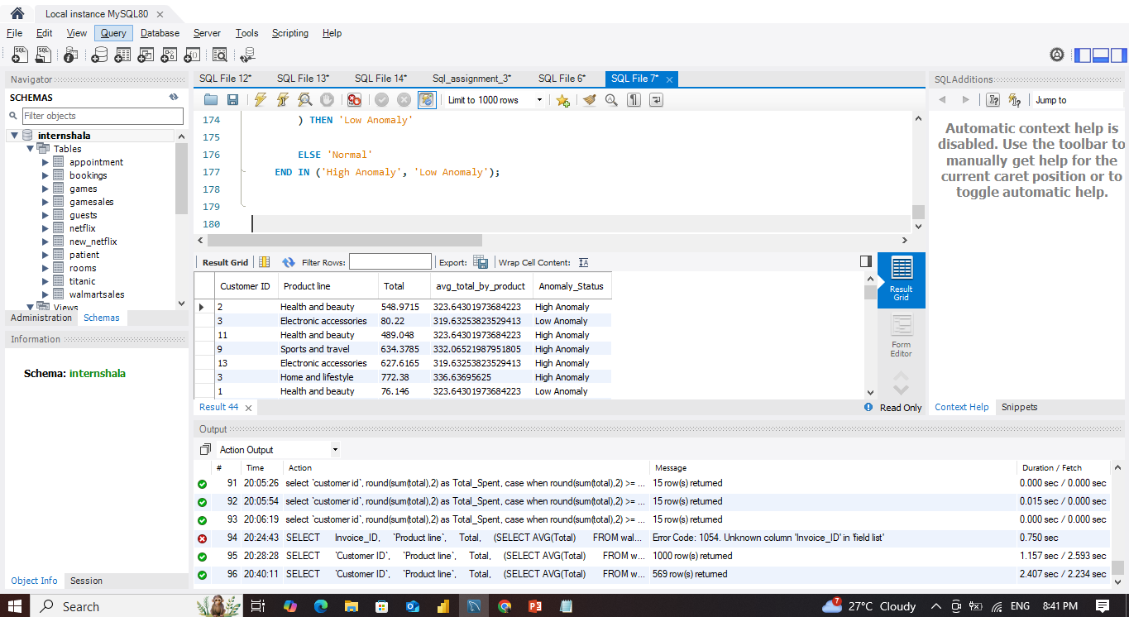
Task 4 Explanation: In this task, I used a subquery to calculate the average Total for each product line. Then, I identified anomalies by comparing each customer's total purchase with the average:
If the purchase was ≥ 1.5× the average, it was marked as a High Anomaly
If it was ≤ 0.5× the average, it was marked as a Low Anomaly
Other values were labeled Normal
Finally, I filtered the results to show only High and Low anomalies.
Query Used- SELECT `Customer ID`, `Product line`, Total, (SELECT AVG(Total) FROM walmartsales AS ws2 WHERE ws2.`Product line` = ws1.`Product line`) AS avg_total_by_product, CASE WHEN Total >= 1.5 * ( SELECT AVG(Total) FROM walmartsales AS ws2 WHERE ws2.`Product line` = ws1.`Product line` ) THEN 'High Anomaly' WHEN Total <= 0.5 * ( SELECT AVG(Total) FROM walmartsales AS ws2 WHERE ws2.`Product line` = ws1.`Product line` ) THEN 'Low Anomaly' ELSE 'Normal' END AS Anomaly_StatusFROM walmartsales AS ws1WHERE CASE WHEN Total >= 1.5 * ( SELECT AVG(Total) FROM walmartsales AS ws2 WHERE ws2.`Product line` = ws1.`Product line` ) THEN 'High Anomaly' WHEN Total <= 0.5 * ( SELECT AVG(Total) FROM walmartsales AS ws2 WHERE ws2.`Product line` = ws1.`Product line` ) THEN 'Low Anomaly' ELSE 'Normal' END IN ('High Anomaly', 'Low Anomaly');
Analysis : Total 44 anomalies found in the data as high and low anomalies.

Slide 6
Task 5 : I wrote a SQL query using a CTE with ROW_NUMBER() to find the most frequently used payment method in each city. Then grouped the data by city and payment, counted the occurrences, used row number, and filtered to show only the top method per city.
Query used - With Top_Payment_Method as(select city, payment, count(*) as Payment_Method_count,row_number() over (partition by city order by count(*) desc) as rnfrom walmartsalesgroup by city, paymentorder by city, Payment_Method_count desc)select * from Top_Payment_Methodwhere rn = 1;
Analysis: Ewallet is the top payment method in both Yangon and Mandalay, indicating high digital adoption in these urban areas.
In contrast, Naypyitaw still favors cash, suggesting a preference for traditional payment methods in that city.
This insight can help Walmart promote digital wallet discounts in Yangon and Mandalay.
Introduce loyalty programs or cash-back incentives for cash users in Naypyitaw to encourage digital transitions.
City | Most_Popular_Payment | Payment_Count
Mandalay | Ewallet | 113
Naypyitaw | Cash | 124
Yangon | Ewallet | 126

Slide 7
Task 6 : Extracted the month from the sales_date using DATE_FORMAT(sales_date, '%b').
Grouped the data by gender and month to get sales for each gender in each month.
Sum the total column to calculate overall sales per group.
Rounded the total sales to 2 decimal places for clean reporting.
Sorted the result by gender and descending sales for readability.
Query used - select * from walmartsales;select gender, date_format(sales_date, '%b') as Months, round(sum(total),2) as TotalSalesfrom walmartsalesgroup by gender, Monthsorder by gender, TotalSales desc;
Gender | Month | Total Sales (₹)
Female | Jan | 59,138.98
Female | Feb | 56,335.56
Female | Mar | 52,408.39
Male | Jan | 57,152.89
Male | Feb | 40,883.82
Male | Mar | 57,047.12
Analysis: Highest Sales: Female customers in January (₹59,138.98).
Lowest Sales: Male customers in February (₹40,883.82).
In February, the gap between male and female sales is most noticeable (≈₹15,452 difference).
Male and female sales are quite close in January and March, but female customers show slightly higher engagement in Jan–Feb overall.

Slide 8
Task 7 Explanation: I calculated the average total purchase amount (AvgTotal) for each combination of Customer Type and Product Line using a CTE. Then I applied a RANK() window function to identify the most preferred product line for each customer type based on highest average total.
Query used -With Best_Productline as (select `Customer type`, `Product line`, round(avg(total),2) as AvgTotal, rank() over(partition by `Customer type` order by avg(total) desc) as RankCustomerType from walmartsales group by `Customer type`, `Product line`) select * from Best_Productline where RankCustomerType = 1
Customer Type | Product Line | AvgTotal
Member | Health and beauty | 353.85
Normal | Sports and travel | 340.36
Analysis: Members preferred the Health and Beauty product line the most based on average spending, indicating a focus on self-care and wellness.
Normal customers spent the most on Sports and Travel, hinting at occasional high-value purchases or seasonal needs.
These insights will help Walmart tailor marketing and promotions to different customer segments effectively.

Slide 9
Task 8: I wrote a query that filters Walmart's sales data to only include records from March, for the 30 days timeline, then grouped the data by each customer id and counted how many transactions (invoices) each customer made in that month. Finally, I sorted the result in descending order of transaction count to identify the customers with the most repeat purchases in March.
Analysis: A total of 15 customers had between 15 and 30 purchases in March. Customer ID 5 made the highest number of purchases (30 transactions), followed closely by Customer ID 9 (29 transactions) and Customer ID 12 (27 transactions). The lowest in the list, Customer ID 13, still made 15 purchases, which is significant for a single month.
Month | Customer ID | Transaction Count
Mar | 5 | 30
Mar | 9 | 29
Mar | 12 | 27
Mar | 7 | 26
Mar | 8 | 25
Mar | 4 | 24
Mar | 14 | 24
Mar | 2 | 23
Mar | 3 | 22
Mar | 11 | 22
Mar | 15 | 22
Mar | 6 | 20
Mar | 10 | 18
Mar | 1 | 18
Mar | 13 | 15
Query used: select date_format(sales_date, '%b') as Months, `customer id`, count(`invoice id`) as TransactionCount from walmartsalesgroup by Months, `customer id`having Months = 'Mar'order by TransactionCount desc;

Slide 10
Task 9 Explanation:
I calculated the revenue each customer generated and used a window function to rank them. Then, I filtered to display only the top 5 customers based on their revenue contribution. All I have done inside a CTE.
Query used: with Top_5_Customers as(select `customer id`, round(sum(`unit price` * quantity),2) as Revenue,rank() over(order by sum(`unit price` * quantity) desc) as Rankingfrom walmartsalesgroup by `customer id`)select * from Top_5_Customerswhere ranking in (1,2,3,4,5);
Customer ID | Revenue (₹) | Ranking
8 | 25,366.04 | 1
3 | 22,287.87 | 2
2 | 22,278.36 | 3
15 | 21,594.72 | 4
1 | 21,556.71 | 5
Analysis: Customer ID 8 is the highest contributor with ₹25,366.04 in total purchases.
The top 5 customers all generated over ₹21,500 individually, indicating a strong influence on overall sales.
These high-revenue customers can be considered premium buyers, and Walmart can:
Offer them exclusive deals or rewards,
Include them in early-access sales, or
Promote them into loyalty membership tiers.
This analysis helps Walmart maximize revenue retention by focusing on its most valuable customers.

Slide 11
Task 10 Explanation: I extracted the day name from sales_date using DAYNAME(), grouped total sales by day, and sorted them to identify which day generates the highest revenue
Query used: select dayname(sales_date) as NameofDay, round(sum(total),2) as TotalSales from walmartsalesgroup by NameofDayorder by TotalSales desc;
Day of Week | Total Sales (₹)
Saturday | 56,120.81
Tuesday | 51,482.25
Thursday | 45,349.25
Sunday | 44,457.89
Friday | 43,926.34
Wednesday | 43,731.14
Monday | 37,899.08
Analysis: Saturday had the highest sales (₹56,120.81), followed by Tuesday (₹51,482.25).
Monday had the lowest total sales, suggesting it's the least active shopping day.
This trend indicates that:
Weekends (especially Saturday) are peak sales periods — likely due to customer availability.
Mid-week and Monday show lower sales, suggesting potential for targeted promotions to balance store traffic.
Business Insight: Walmart can use this analysis to optimize staffing, inventory stocking, and run weekday offers to drive more weekday traffic.

Slide 12
Walmart Data analysis and insights
Business Insights & Recommendations for Walmart
Key Insights:
Branch A shows the highest month-on-month sales growth, indicating strong demand or efficient performance in that location.
Food & Beverages and Health & Beauty are the most profitable product lines across different branches.
Members tend to prefer Health & Beauty products, while Normal customers spend more on Sports & Travel items.
Repeat purchase behavior is prominent among a few customers — Customer ID 5 and 8 made over 25 purchases in March alone.
High-spending customers are focused on a few product lines, suggesting potential for premium product upselling.
Saturday generates the highest total sales, followed by Tuesday, while Monday is the lowest-performing day.
Recommendations:
Introduce loyalty programs for high-value and repeat customers to improve retention and lifetime value.
Optimize inventory planning by focusing on high-demand product lines in top-performing branches.
Increase staff and promotions on weekends to handle peak sales and offer weekday deals to balance traffic.
Use customer segmentation to run targeted marketing campaigns based on preferences and spending behavior.
Monitor anomalies in customer purchase patterns to detect potential fraud or unusual activity early.

